Slide 1

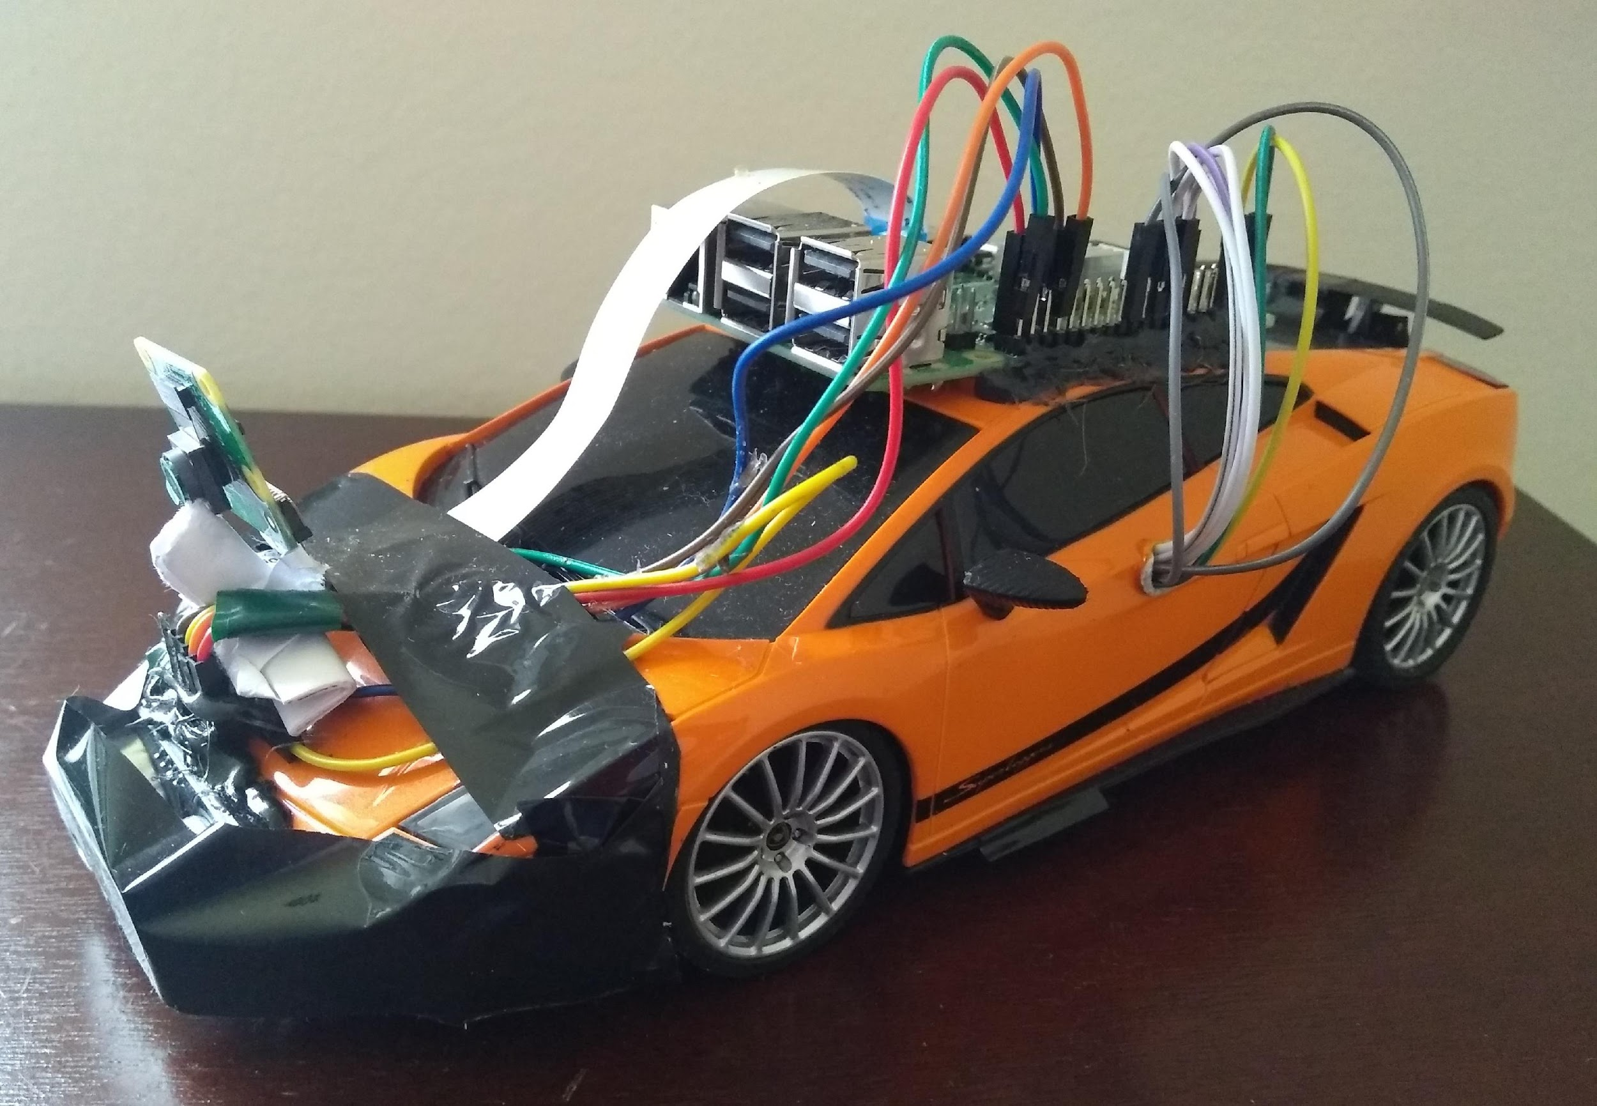
Deep Q-Network (DQN) Based Lane Following Toy Car
Dipam Patel
Shivang Patel
ENPM808F

Slide 2
Outline
Introduction
Description of Project
Description of Robot Car
Architecture of Deep Q-Network (DQN)
Experiment
Results
Summary
Future Work
References
ENPM808F | Final Project

Slide 3
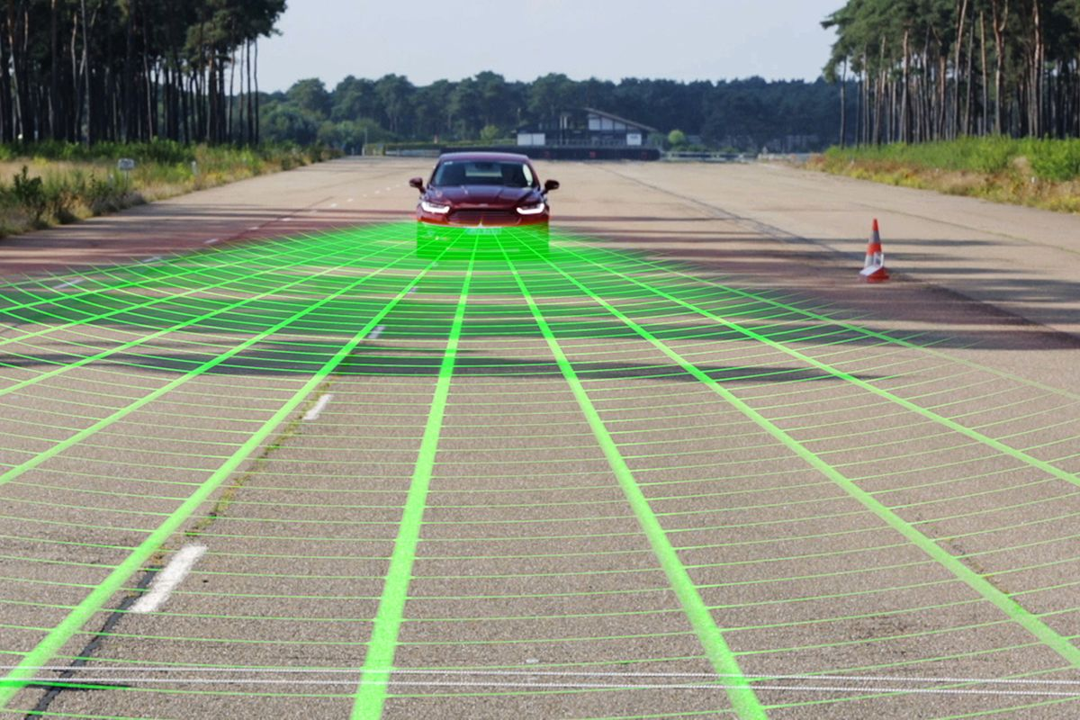
Introduction
Most approaches in Autonomous Driving rely on external mapping infrastructure instead of understanding the local scene
The generality of reinforcement learning makes it a useful framework to apply to autonomous driving
Reinforcement Learning demonstrates a
new framework for autonomous driving
which moves away from reliance on
defined logical rules, mapping and direct
supervision
ENPM808F | Final Project

Slide 4
Description of Project
This project aims to implement the Deep Q-Network (DQN) Algorithm to train a Toy Car to drive by itself while following the lanes
Using only the monocular camera image as input, the car is trained to follow the lanes without any previously collected data for training
The algorithm is rewarded based on the distance travelled by the car before it leaves the lane and is stopped by the supervisor by giving a negative reward
A model-free approach based on the trial and error strategy where it keeps updating its knowledge
ENPM808F | Final Project

Slide 5
Description of Project
From the randomly initialized parameters, the model is trying to learn a policy for lane following and optimizing it on the go
Used Raspberry Pi 3B+ as an onboard processor on the car to stream frames and perform the actions (forward, left and right) received from the computer which acted as the central processor
Used ROS for communication between Raspberry Pi and Computer
Tensorflow 1.8.0 framework was used to train the convolutional neural network
ENPM808F | Final Project

Slide 6
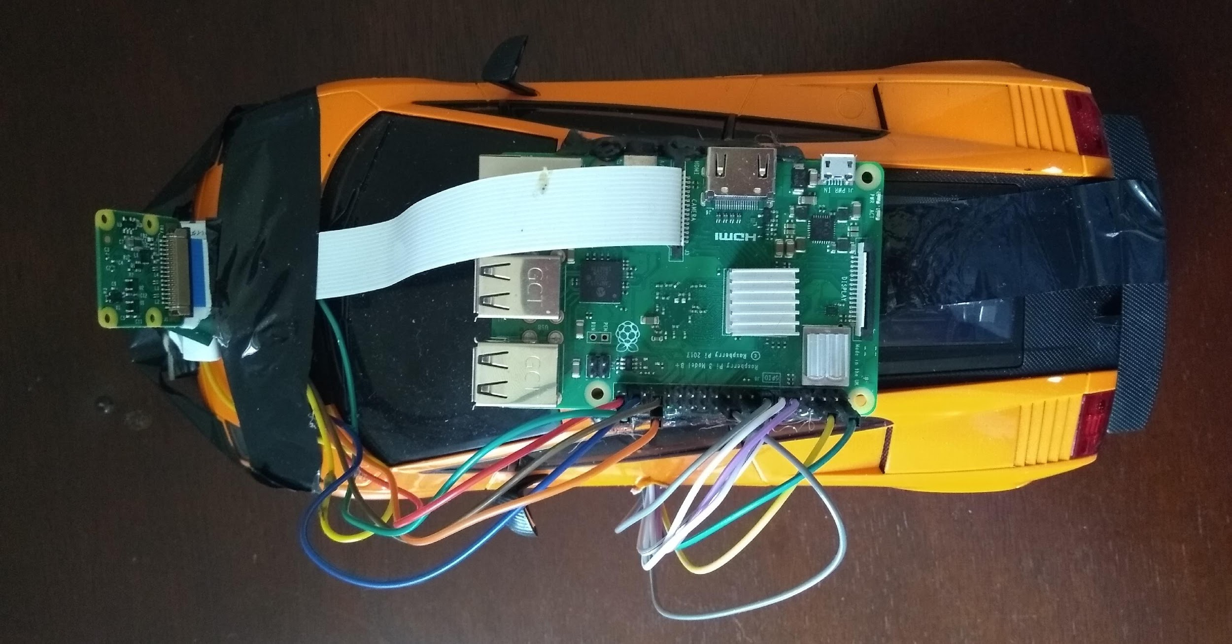
Description of Robot Car
Raspberry Pi Camera v2.1
Raspberry Pi 3B+
Cables Connected to L293D Motor Driver
ENPM808F | Final Project

Slide 7
Description of Robot Car
Hardware Used
RC Toy Car
Raspberry Pi 3B+
Raspberry Pi Camera v2.1
L293D Motor Driver
Cables
Batteries
Track Details: White Paper as Track and Black Tape as Lanes
ENPM808F | Final Project

Slide 8
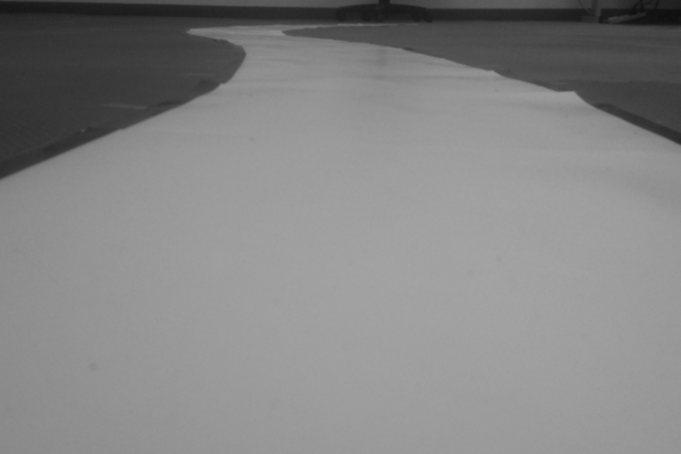
Architecture of Deep Q-Network (DQN)
Instead of just using a Q-table, we implement a Neural Network that takes a state and approximates Q-values for each action based on that state
The Neural Network takes a stack of four frames as input, passed through its network and output a vector of Q-values for each of the three actions
Initially, the agent performs really worse, but with time, it begins to associate frames (states) with best action
Flatten
FC
512 units
FC
3 units
F
Layer 1
Layer 2
Layer 3
F+L
F+R
ENPM808F | Final Project

Slide 9
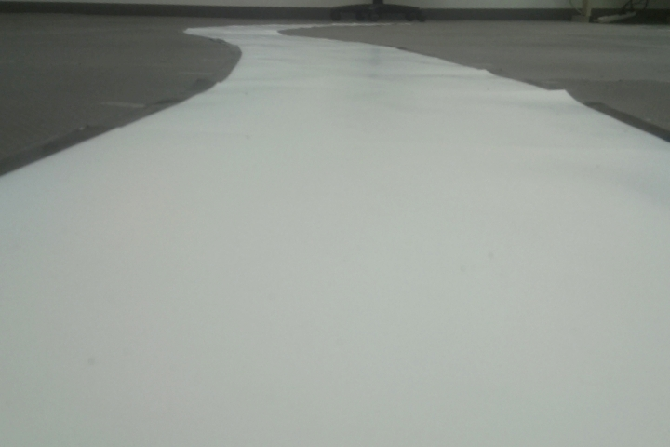
Preprocessing Part
Reducing the complexity of the states to reduce the computation time needed for training
Convert RGB to Grayscale as color is trivial
Crop the frame from the top to reduce its size and stack four sub-frames together
ENPM808F | Final Project

Slide 10
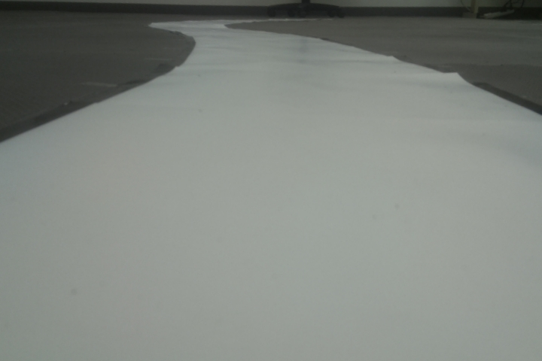
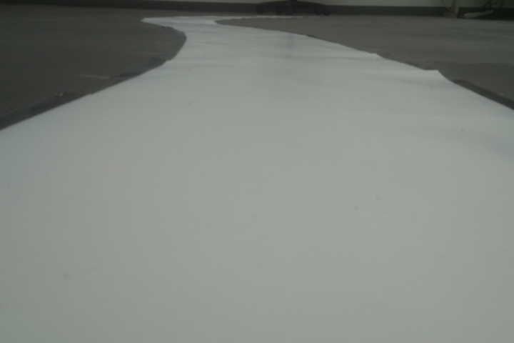
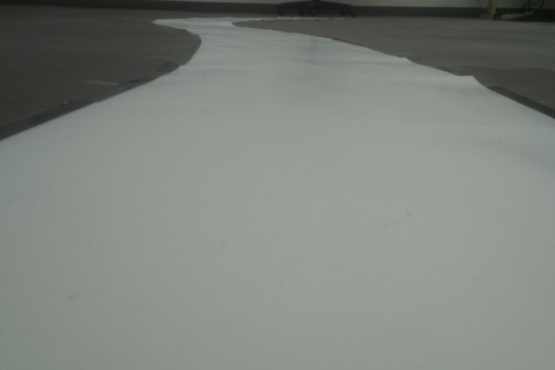
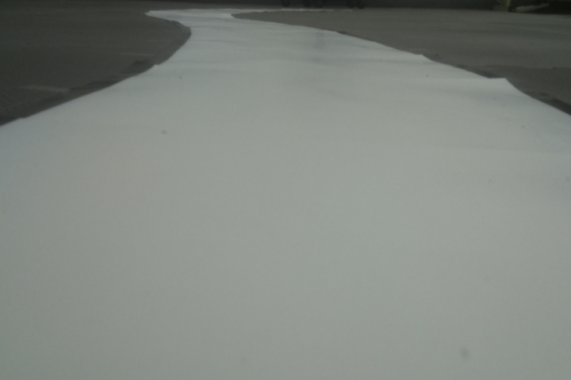
Problem of Temporal Limitation
One frame is not enough to have the sense of motion
ENPM808F | Final Project

Slide 11
Experience Replay
Avoid forgetting previous experiences
Tends to forget the previous experiences as it overwrites with new one
More efficient to use previous experience by learning from it multiple times and create a replay buffer
Reduce correlations between experiences
Every action affects the next state- outputs sequence of experience tuples which can be highly correlated
By sampling from the replay buffer at random, the correlation is avoided and the action values are prevented from diverging greatly
ENPM808F | Final Project

Slide 12
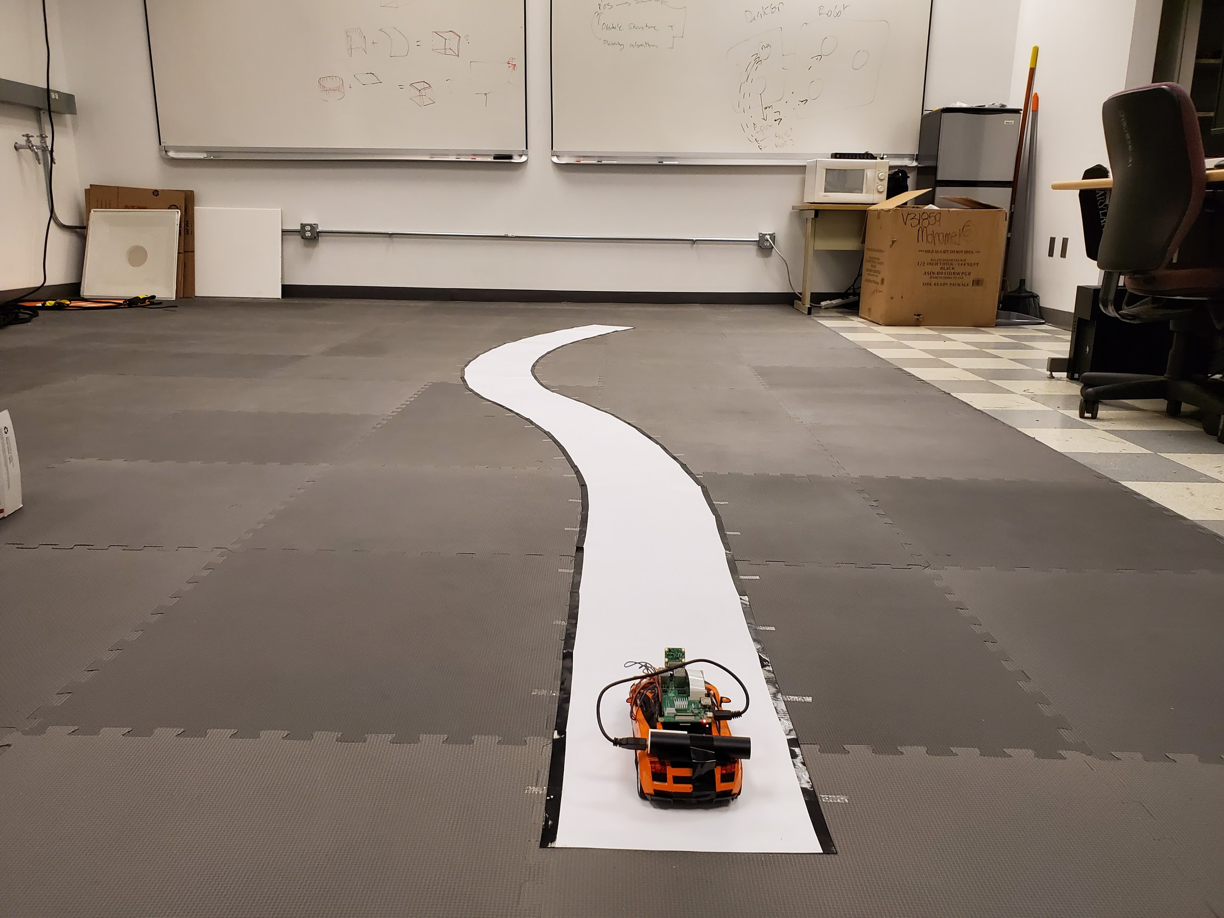
Experimentation
ENPM808F | Final Project

Slide 13

Software Setup
RASPI NODE
ROSCORE
CAM PUB
COMPUTER NODE
CMD SUB
TOY CAR

Slide 14
Reward Model
Leaving the Lane: -10
Following the Lane: +5
Completing the Lane: +10

Slide 15
Insight into Training Params
STATE SIZE [200, 200, 4]
ACTION SIZE 3 i.e. Left, Right and Forward
Learning Rate 0.01
Exploration 1 to 0.01
Decay rate 0.001
Gamma 0.95
Memory size 1500
Batch size 64

Slide 16
Training Video
https://drive.google.com/file/d/180Qn422pd3R9GoEO2Z3jaWm0X48zOT9E/view
ENPM808F | Final Project

Slide 17
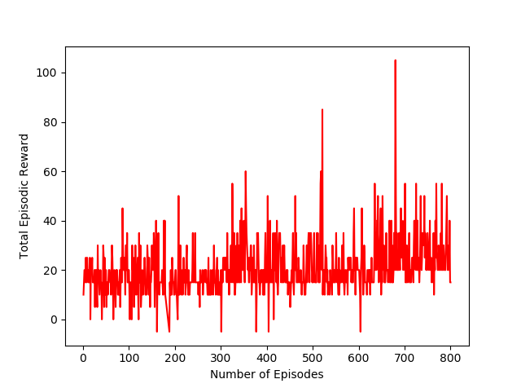
Episodic Reward v/s Episode (Training)
ENPM808F | Final Project

Slide 18
Testing Video
https://drive.google.com/file/d/1rllwzH8UelCLR_YSGW9ly_s5jMo-VzgR/view

Slide 19
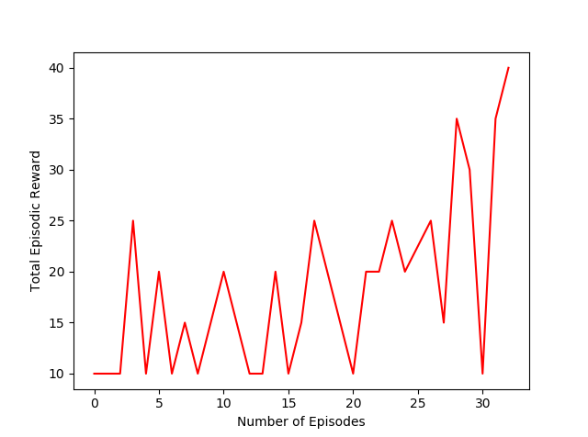
Episodic Reward v/s Episode (Testing)

Slide 20
Hardware Limitations
The variable command delay between Toy car and Computer.
Computer’s Memory limitation for the Experience Replay.

Slide 21
Summary
Trained an actual Toy Car to follow Lane using a DQN Reinforcement Learning Technique
Used Experience Replay and Frame Stacking approach for better performance
ENPM808F | Final Project

Slide 22
Future Work
Train a car in a simulated environment based on the camera input and steering angles for a large number of episodes.
Transferring the trained model to the toy car and testing on the track would give the desired output as the learning policy would be tuned to be optimal for the task.
Training data would be cheap, auxiliary ground-truth information can be provided with ease, the vehicle can be put into situations that are difficult and more number of episodes can be executed.
ENPM808F | Final Project

Slide 23
References
Alex Kendall, Jeffrey Hawke, David Janz, Przemyslaw Mazur, Daniele Reda, John-Mark Allen, Vinh-Dieu Lam, Alex Bewley, Amar Shah, “Learning to Drive in a Day”
Alex Bewley, Jessica Rigley, Yuxuan Liu, Jeffrey Hawke, Richard Shen, Vinh-Dieu Lam, Alex Kendall, “Learning to Drive from Simulation without Real World Labels”
Peter Wolf1, Christian Hubschneider1, Michael Weber1, Andr´e Bauer2, Jonathan H¨artl2, Fabian D¨urr2, J. Marius Z¨ollner1,2, “Learning How to Drive in a Real World Simulation with Deep Q-Networks”, 2017 IEEE Intelligent Vehicles Symposium (IV), June 11-14, 2017, Redondo Beach, CA, USA
Christopher Watkin, “Learning from Delayed Rewards”
Tim Elfrink, “Performance of Exploration Methods using DQN”
Martin Riedmiller, Mike Montemerlo, Hendrik Dahlkamp, “Learning to Drive a Real Car in 20 Minutes”, Frontiers in the Convergence of Bioscience and Information Technologies 2007
https://medium.freecodecamp.org/an-introduction-to-deep-q-learning-lets-play-doom-54d02d8017d8
https://zhengludwig.wordpress.com/projects/self-driving-rc-car/
https://towardsdatascience.com/build-your-own-self-driving-toy-car-ad00a6804b53
https://github.com/bdjukic/selfdriving-robot-car
https://blog.floydhub.com/toy-self-driving-car-part-one/
https://github.com/RyanZotti/Self-Driving-Car
https://medium.com/@jonathan_hui/lane-keeping-in-autonomous-driving-with-model-predictive-control-50f06e989bc9
ENPM808F | Final Project

Slide 24
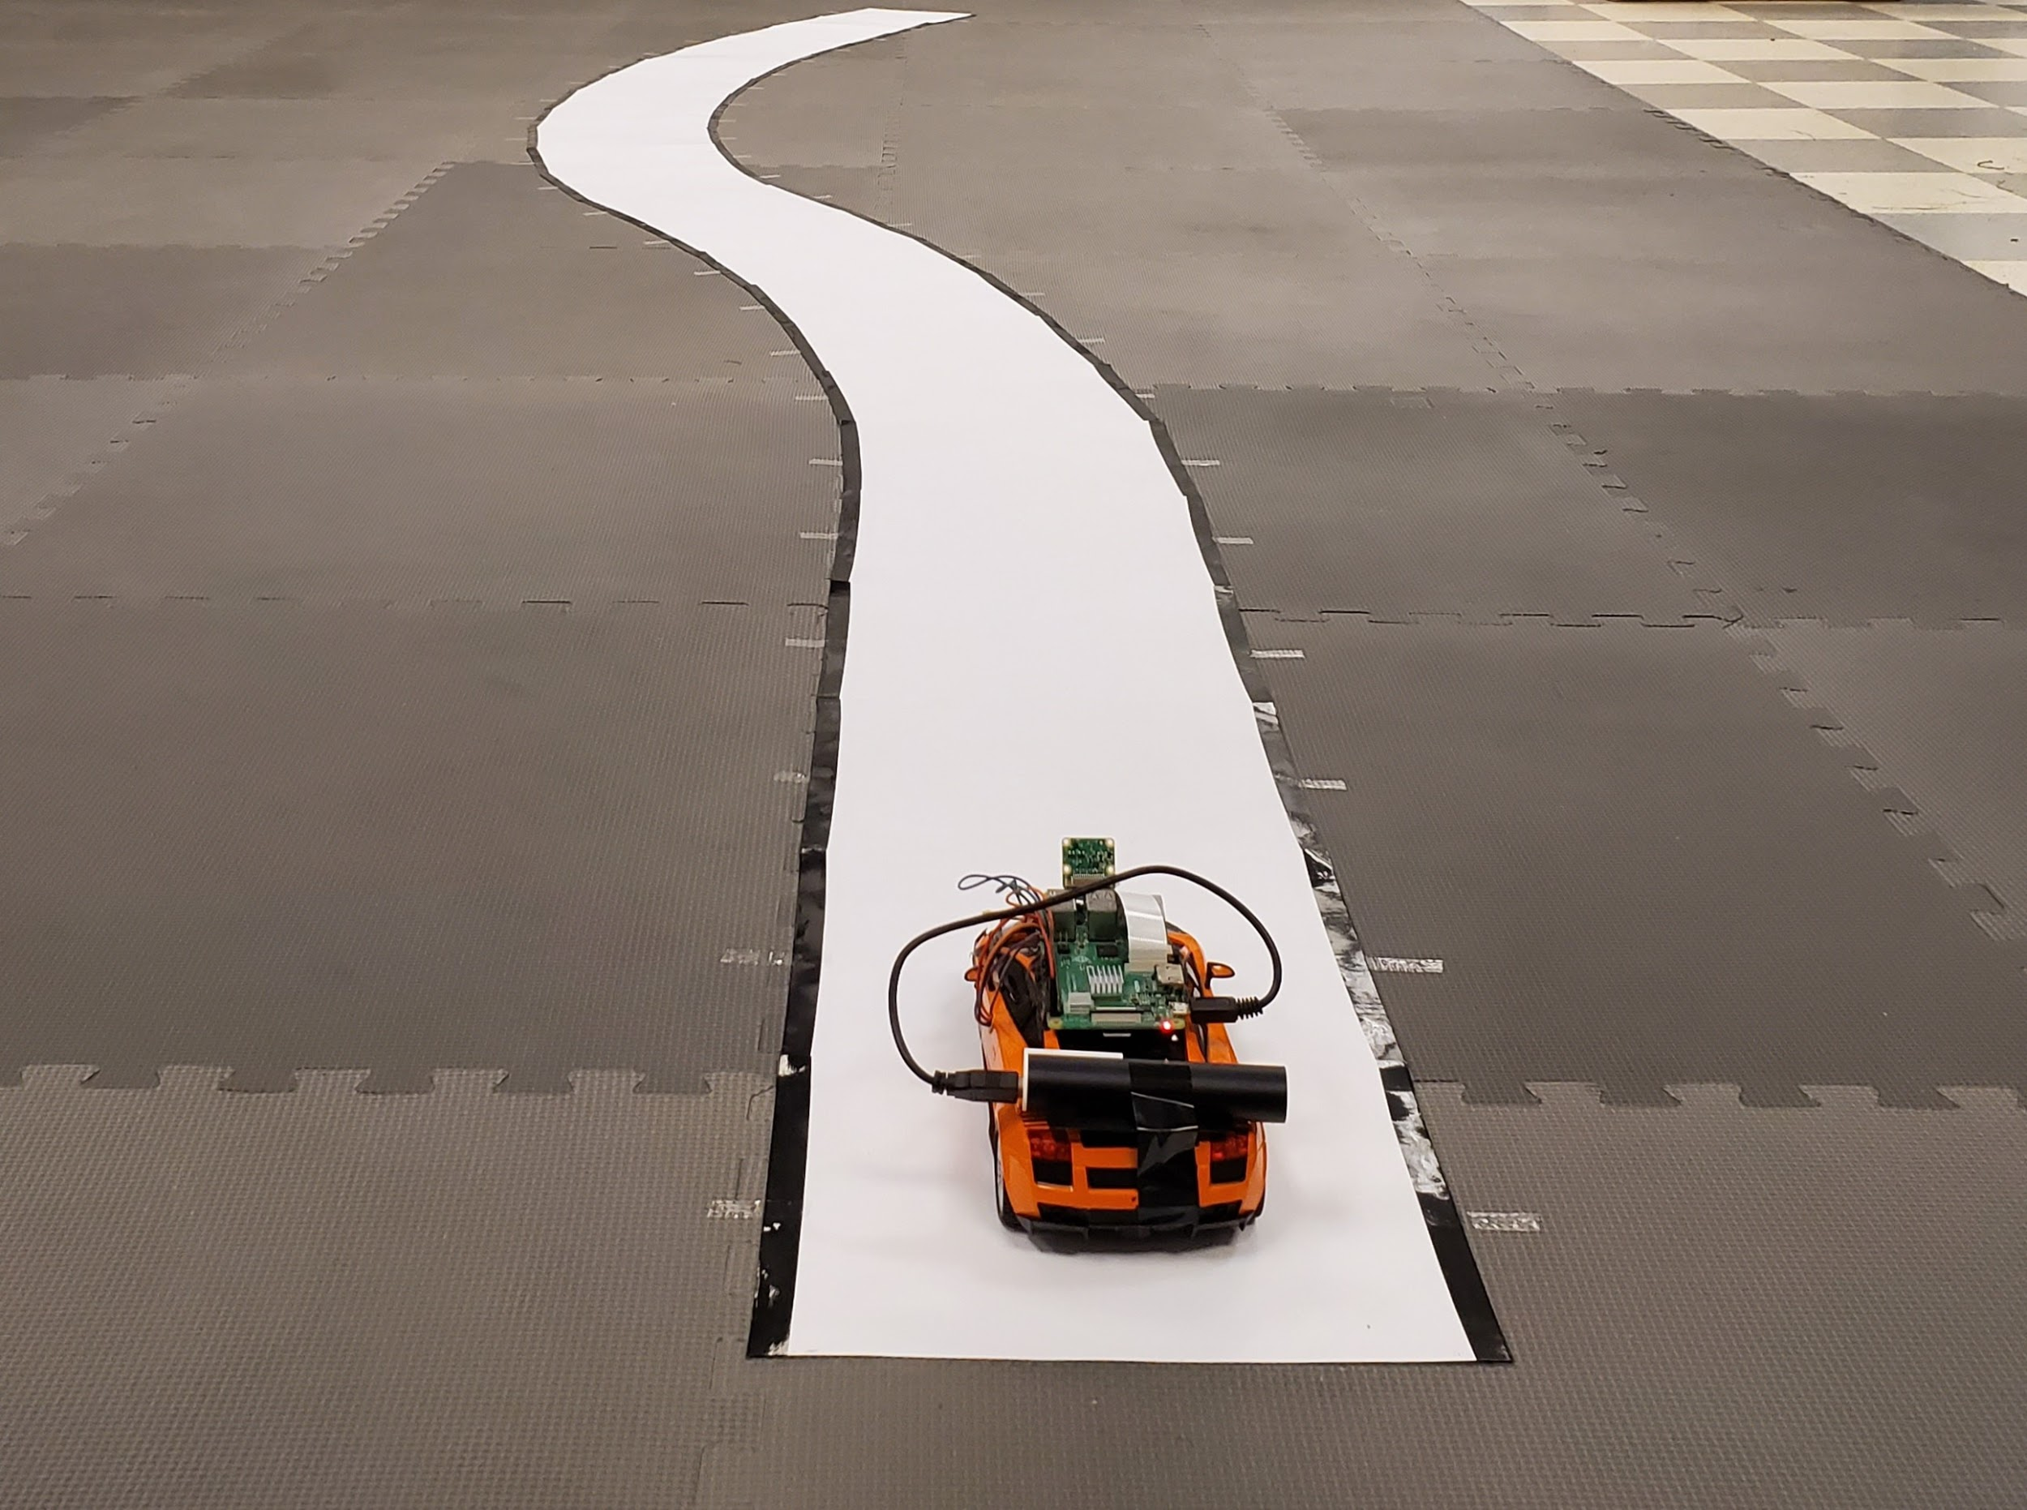
Thank you!
ENPM808F | Final Project

